Slide 1
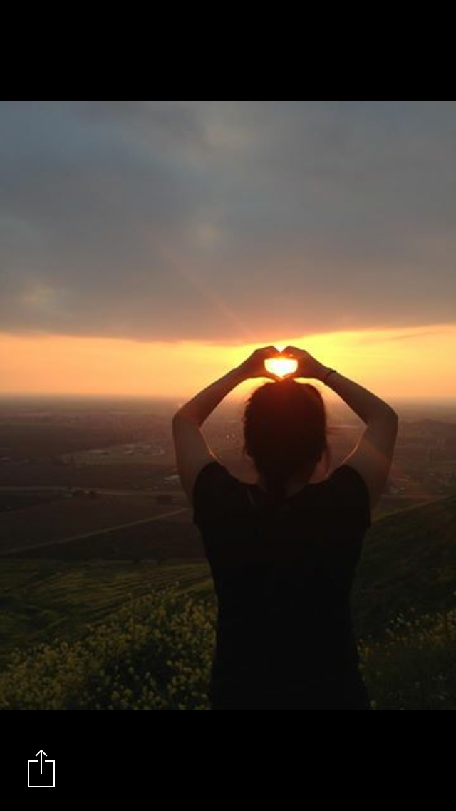
Marisol Gonzalez

Slide 2
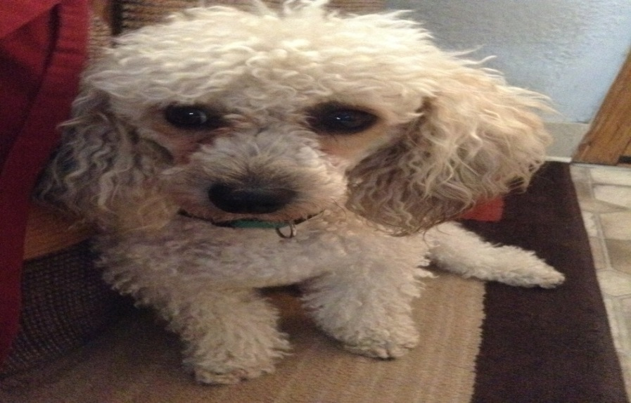
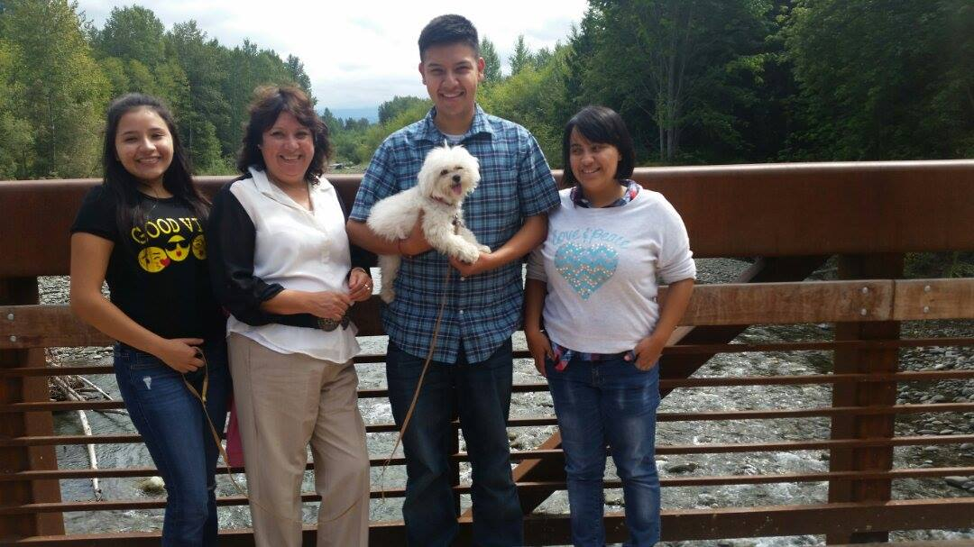
About me
Born and raised in Lindsay, CA
Family of 5
Youngest child out of 3
Love spending time with my family and my dog
Sports, reading
my dogs death

Slide 3
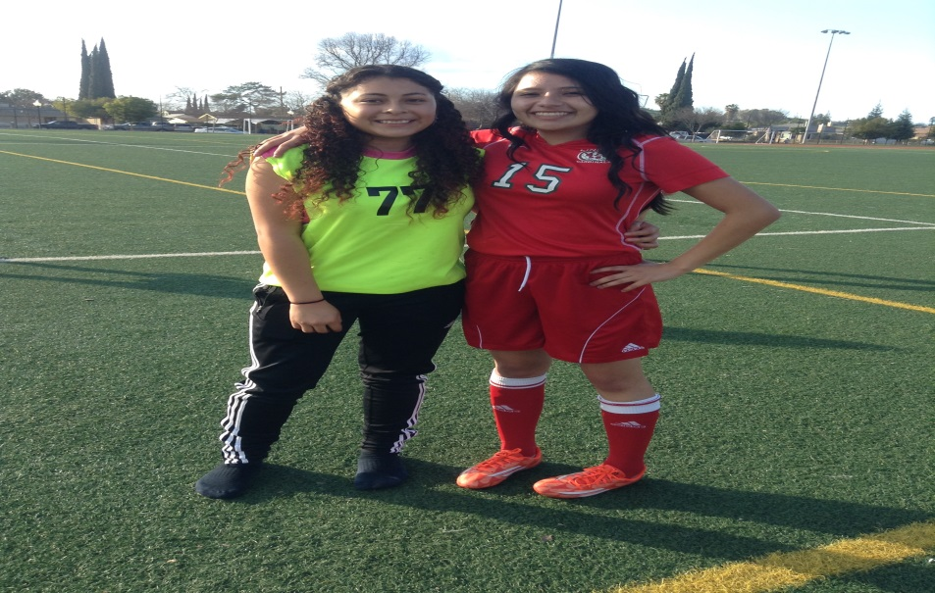
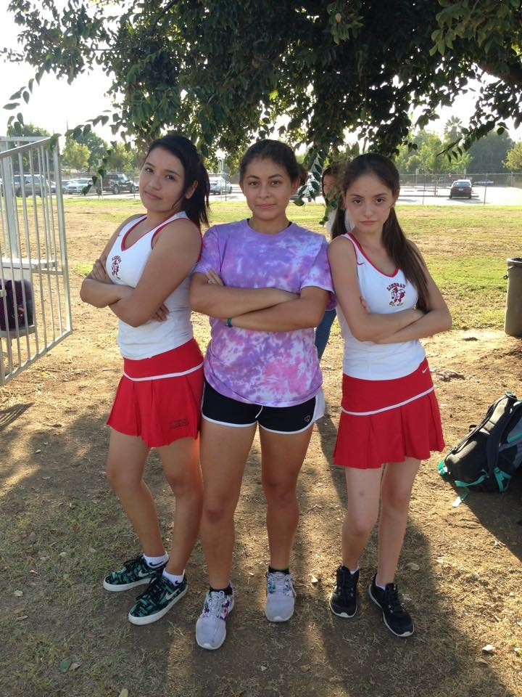
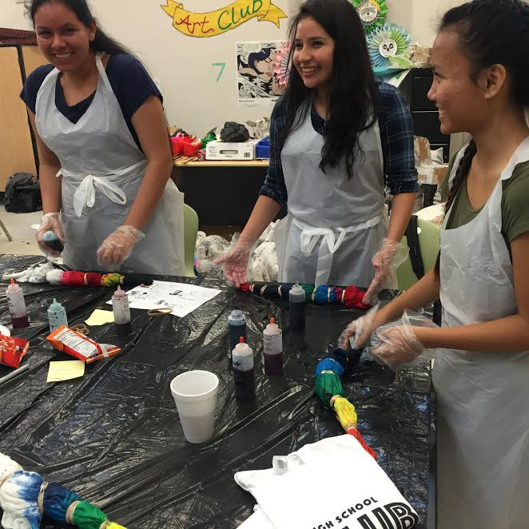
High school experience
Tennis, soccer, color guard
clubs
My voice, key club, art club, ASL, National Spanish honors society and leadership/ASB
Volunteered in community hours
New challenges and struggles along the path

Slide 4
Job shadow
Pediatrician
Dr. Aurora Grace
Requires patience, love for kids, and experience
Used bilingualism to aid translation
Watched her do what she knows best
Not personal field of interest

Slide 5
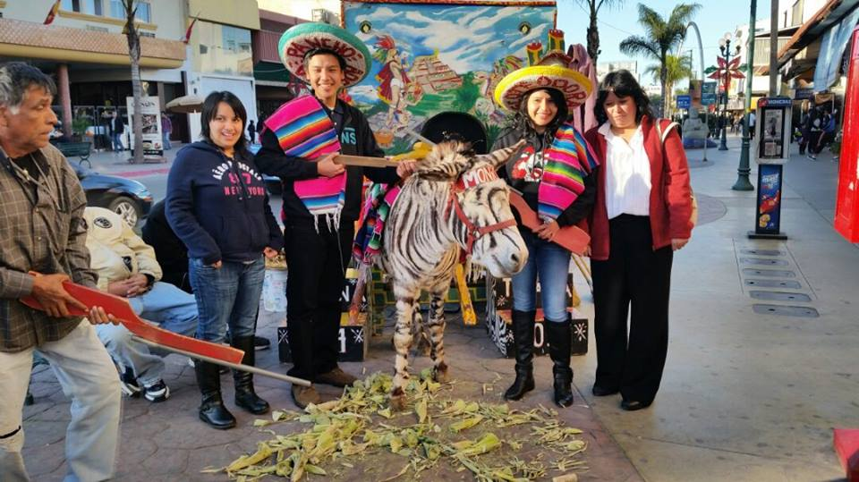
Pathway
Spanish
I learned many words that I've never heard before
This will help me in the future
National Spanish honors

Slide 6
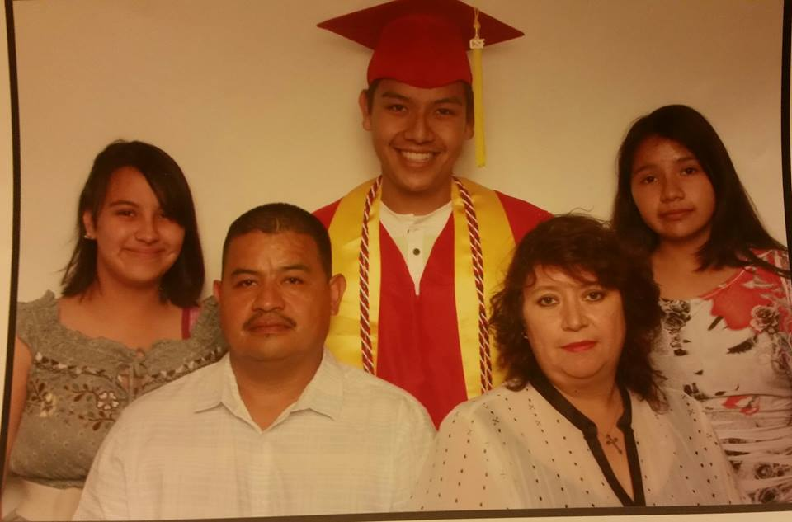
My motivators My family

Slide 7
Post- high school plans
Attend college of the sequoias
Teaching credential
Transferring to CSU Bakersfield
Bachelors degree
Elementary teacher
Kinder – 4th grade

Slide 8
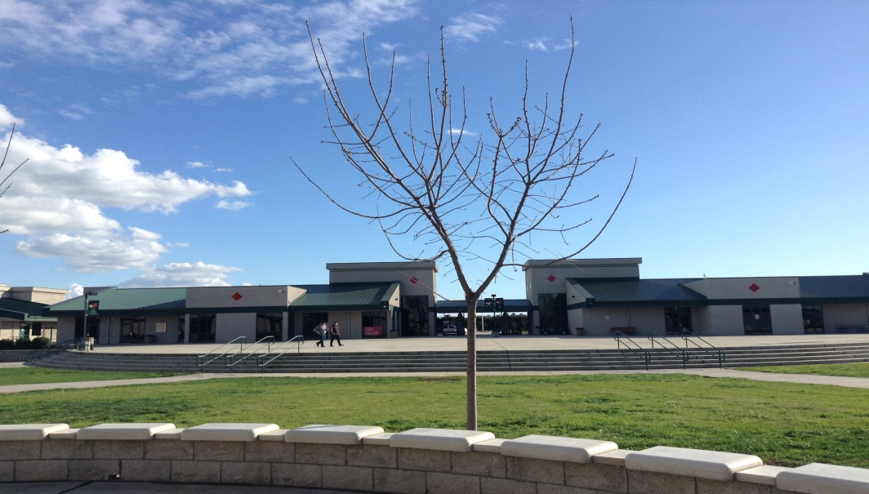
Leaving LHS
Thanks to my counselor Ms. Urutia for always answering my questions
Confronted conflicts
Learned valuable life lessens
Grateful for those friendships I made

Slide 9
Thank you panelists Any Questions?

